Slide 1

Caloric Burn Monitoring as a clinical Support Tool
Date : June 22, 2025

Slide 2
Agenda
Problem Statement for use case
Introduction & Executive Summary
Proposed Solutions
Business Needs
Benefits of the proposed Solutions
Live Demo, Q & A

Slide 3
Problem Statement for use case
Mental health clinicians lack continuous, objective data between sessions Caloric burn, a key indicator of physical activity, is linked to mental health. Current practices often miss early signs of behavioral or emotional decline. A tool to monitor caloric burn can enhance real-time insights and personalized care

Slide 4
Introduction & Executive Summary
Introduction
Mental health care often relies on self-reported data and periodic check-ins, which may miss important behavioral changes. With the rise of wearable technology, clinicians have the opportunity to access continuous, real-time data—such as caloric burn—that reflects a patient's physical activity and overall mental state.
Executive Summary
Caloric burn monitoring offers mental health professionals real-time insights into patient well-being through wearable technology. By tracking physical activity, clinicians can detect early behavioral changes, personalize treatment, and improve outcomes. This approach enhances care by bridging clinical practice with continuous, data-driven support.

Slide 5
Proposed Solutions
Artificial Intelligence Module (AI-M)
We are proposing state of a art AI Model, which can help and enhance Caloric Burn Monitoring As A Clinical Support Tool, This AI-Tool or Module has many features advance classifications which is very unique to it.
Below is brief on the AI tool or Module.

Slide 6
Business Needs
Many advanced nations are actively seeking innovative technologies that can support and enhance clinical tools—such as caloric burn monitoring—to improve mental health assessment and patient outcomes
Here is the Key Business Needs
Real-time monitoring
Early detection of behavioral changes
Improved patient engagement
Personalized treatment plans
Secure and compliant data handling
Personalized treatment plans

Slide 7
Benefits of the proposed Solutions
In today’s world, the widespread availability of processed and unhealthy food, combined with increasingly sedentary lifestyles, has reduced natural caloric burn compared to the past. Implementing tools that monitor daily caloric burn can offer significant health and economic benefits across many nations.
Key Benefits:
Improve quality of life
Enable early disease prediction
Saving a huge amount of money
Support early detection of behavioral changes
Enhance patient engagement in their own care
Enable personalized treatment planning
Seamlessly integrate with wearable health devices
Scale efficiently for clinics and telehealth platforms
Ensure secure and compliant data management

Slide 8

Exploratory DATA Analysis – DATASET Overview
N = 75000
Features = 8
Target Feature – Calories
Explanatory Features - Sex, Age, Height, Weight, Duration, Heart Rate, Body Temp
All explanatory features are continuous except Sex (Categorical Feature) and Age (Discrete Feature)
% of Observations with Sex as Male = 50.1%
No. of Null Observations = 0

Slide 9
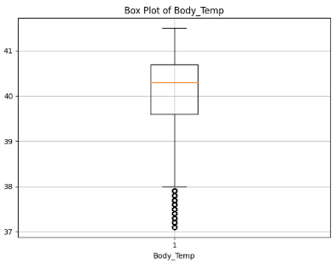
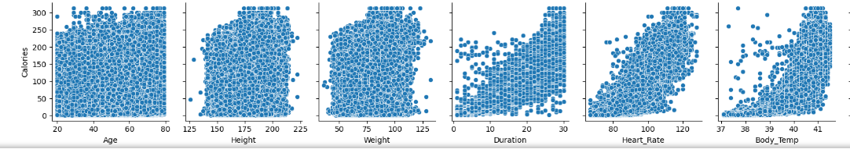
Exploratory DATA Analysis – Insights
Kurtosis: Body Temperature has high kurtosis (0.51), suggesting high number of outliers from the statistical test. However, on deep dive, it was found that this variable has low SD and from common knowledge all observed outliers (20% of total data) actually can be realistically possible (between 35 to 37 degrees)
Linearity: Calorie has a positive linear relationship with duration, heart rate and body temperature.

Slide 10
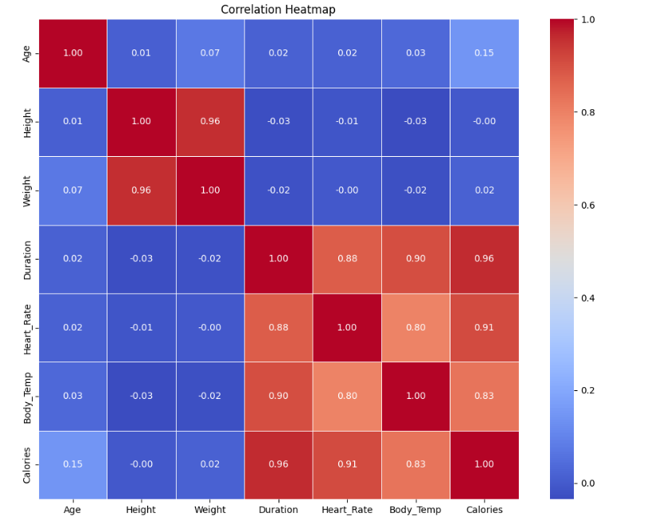
Exploratory DATA Analysis – Insights Contd..
Multi-Collinearity:
High Correlation observed between Height & Weight, and between duration, body temperature, heart rate and calories.
This high correlation makes it difficult to isolate the individual impact of each predictor on the dependent variable, potentially leading to unreliable and unstable regression results. Model Implication:
For multi-collinearity sensitive models such as linear regression, we would need to drop some of the features
To avoid model overfitting
To avoid underestimating effect of the features

Slide 11
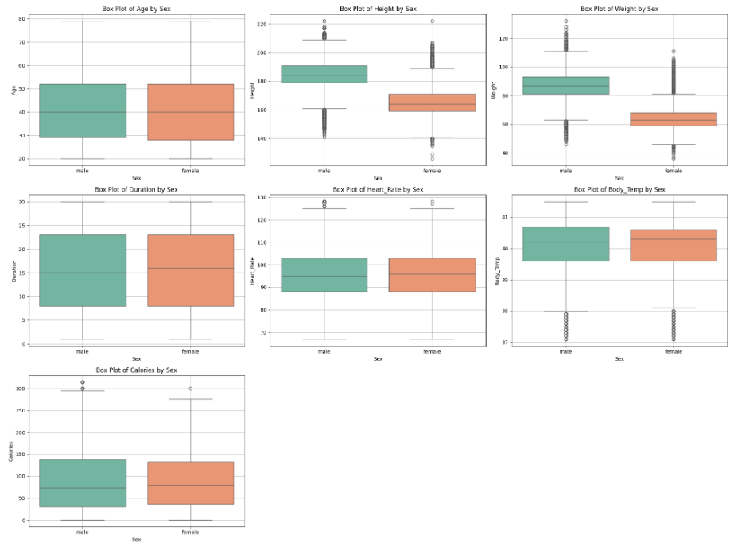
Exploratory DATA Analysis – Insights Contd..
Sex feature doesn’t seem to have any significant relationship with any of the features except height and weight, where it is a known biological fact.
Male
Female

Slide 12
AI Model TRAINING
Data Transformation into a format suitable for AI models (e.g., converting text to numbers). Standardized and encoded features to ensure fair model training
Experimentation with Features
Six sets of datasets, each with different features (data fields) were built for training on each model
Regression Algorithms with multiple model configurations:
Linear Regression, Decision Tree, Random Forest, Gradient Boosting, and XGBoost
Each model was trained to predict how many calories a person burns during exercise

Slide 13
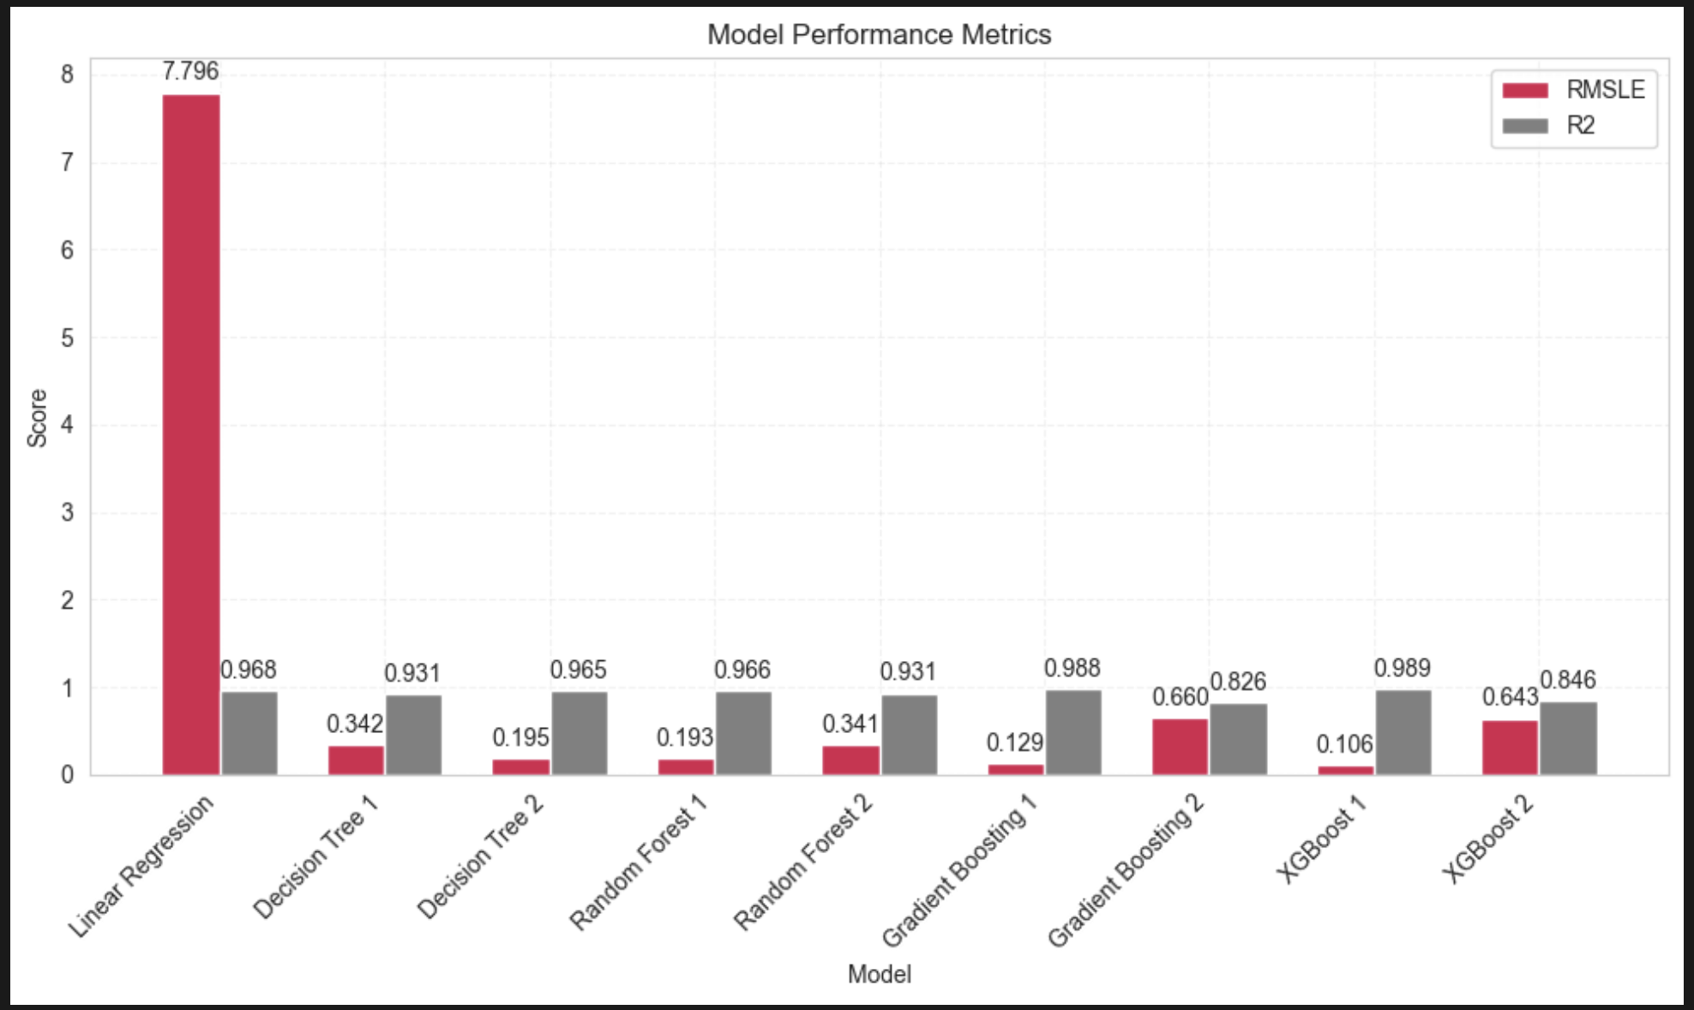
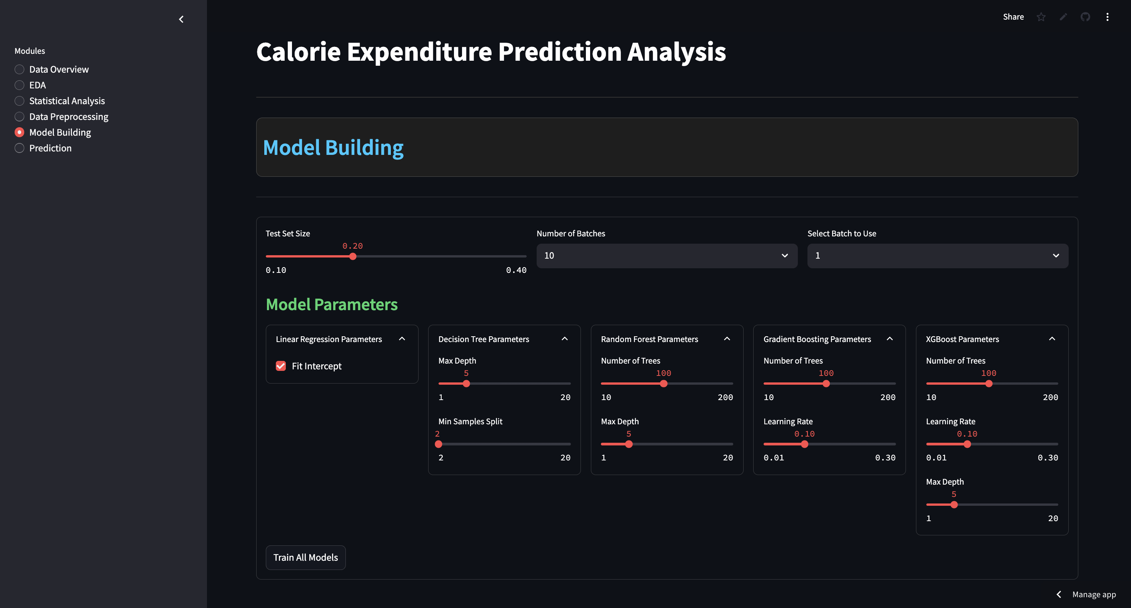
Predictions Results to Real-World Use
1. How We Measured Accuracy:
RMSLE: Measures how close predictions are, while handling big differences gently
R² Score: Tells us how well the model explains what affects calorie burn
2. Top Performer: XGBoost
Achieved 98.9% accuracy (R² = 0.989) with minimal error
Key features: weight, duration, heart rate, and gender
3. Enhancements:
Web application for fast upgradations in the model based on new data

Slide 14
Key areas of each Team Members
Bashir Ali Qule : Business Case Study
Ashis Das : Exploratory Data Analysis
Pankaj Shukla : Model Building

Slide 15
Thanks

